Slide 1
Processing images
Section 6
Notes:
[Mandatory Slide] This would be the introduction slide of the topic that you are covering in this section.
When this slide plays, you could talk about the main aim that we’d be covering in this section.

Slide 2
What We’ll Learn
Reading and showing images with Pillow
Recognizing faces
in pictures
Basic image filtering
Taking a screenshot
Cropping and resizing images
Image watermarking
Parsing QR codes
The fundamental steps to work with images
Enhance your images with fun and colorful filtering
A quick way to save information “on-the-go”
Identify human faces on static images
A compact and quick way to exchange data through images
Fix image dimensions
Protect your images from intellectual property theft

Slide 3
Reading and showing
images with Pillow
Notes:
[Mandatory Slide] This would be the introduction slide of the topic that you are covering in this subsection.
When this slide plays, you could talk about the main aim that we’d be covering in this video.

Slide 4
In this Video, we are going to take a look at…
What images really are
Meet and install Pillow
Code: read and display an image
Notes:
[Mandatory Slide]
Before the start of the video, we’d like to highlight what are important topics or pointers that we’d be covering in this video. This slide would immediately follow the intro/name slide. This would just be say 2-3 points for the viewers to know what they are getting into.

Slide 5
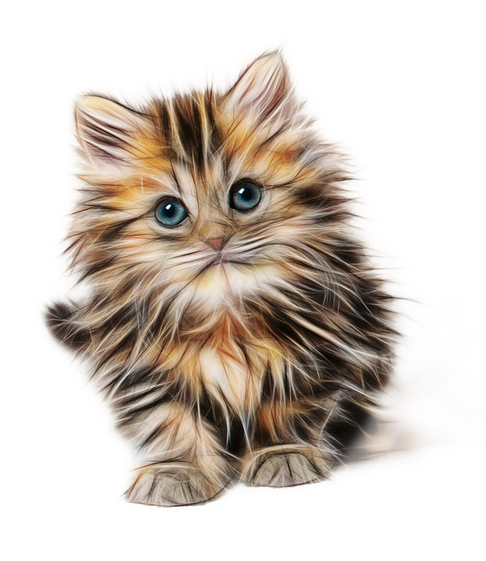
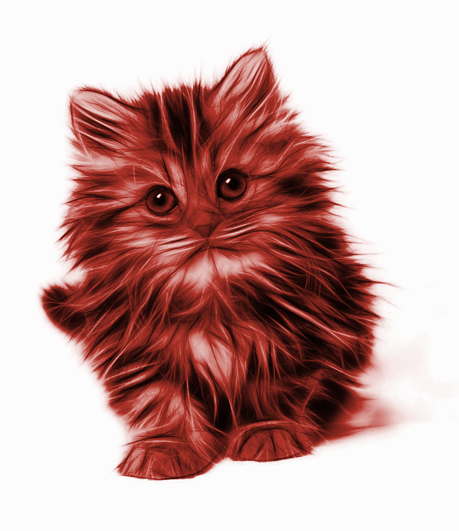
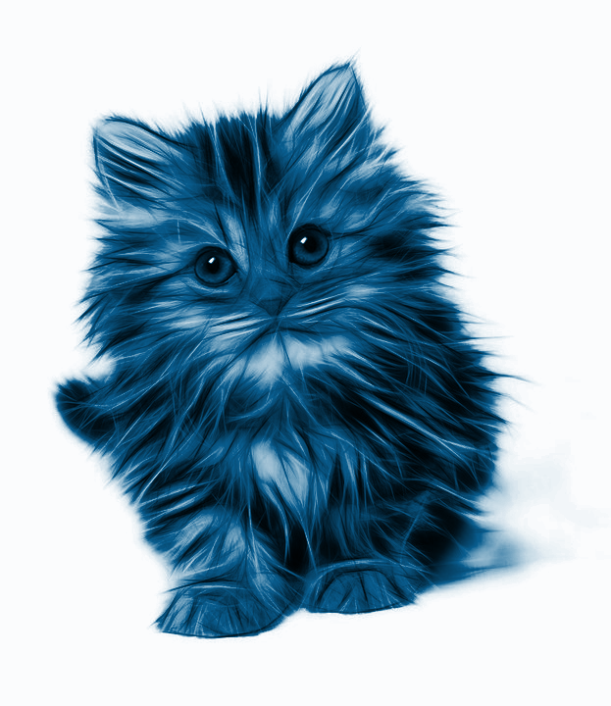
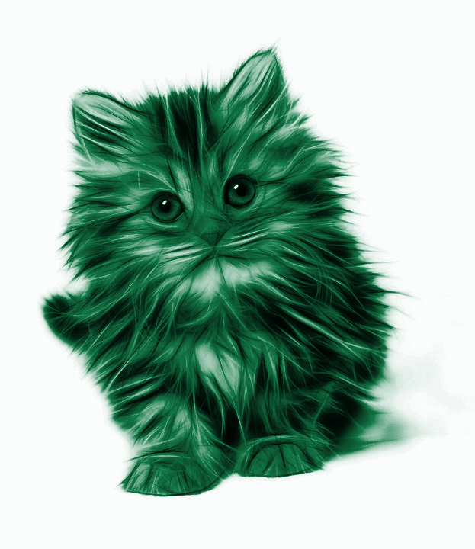


What images really are (1/2)
Images are… data! Each image is a grid of pixels
Each pixel has (X, Y) coordinates
Pixels are arrays of 4 integer values, called color channels: Red, Blue, Green, Alpha
X
Y
Red, Blue and Green are the primary colors that can be mixed to get any color. Alpha gives the transparency of the pixel
Notes:
[Mandatory Slide]
Before the start of the video, we’d like to highlight what are important topics or pointers that we’d be covering in this video. This slide would immediately follow the intro/name slide. This would just be say 2-3 points for the viewers to know what they are getting into.

Slide 6
What images really are (2/2)
R | G | B | Alpha | Pixel
255 | 0 | 0 | 255
0 | 255 | 0 | 255
0 | 0 | 255 | 255
255 | 255 | 255 | 255
0 | 0 | 0 | 255
255 | 0 | 0 | 0

Slide 7
Meet and install Pillow
Pillow is a library for image manipulation, providing:
nice object-oriented abstractions to work with images: Image, ImageColor, ImageDraw, ImageFilter, ImageFont
convenience methods to manipulate images: crop, resize, filter, paste
Installing Pillow is as easy as:
pip install Pillow
Notes:
[Mandatory Slide]
Before the start of the video, we’d like to highlight what are important topics or pointers that we’d be covering in this video. This slide would immediately follow the intro/name slide. This would just be say 2-3 points for the viewers to know what they are getting into.

Slide 8
Code: read and display an image
Notes:
Something that needs to grab the viewers attention!!

Slide 9
Summary
What images really are
Meet and install Pillow
Code: read and display an image
Notes:
[Mandatory Slide]
Before the start of the video, we’d like to highlight what are important topics or pointers that we’d be covering in this video. This slide would immediately follow the intro/name slide. This would just be say 2-3 points for the viewers to know what they are getting into.

Slide 10
Cropping and resizing images
Next Video
Notes:
[Mandatory Slide]
Here the name of the next video needs to be mentioned. The narration as you guessed it would be just letting the viewer know exactly where we are at and what we’d be taking over next! ☺

